Slide 1
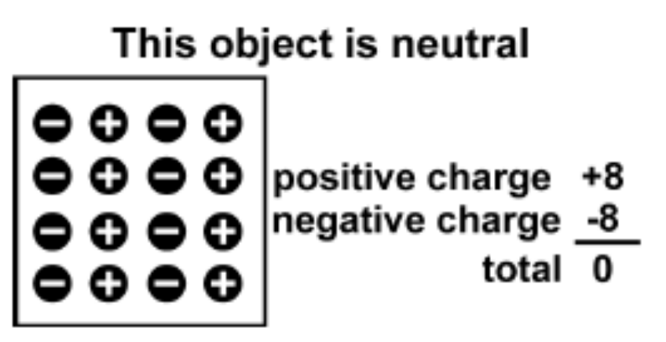
Electric Charge
All ordinary matter contains both positive and negative charge.
You do not usually notice the charge because most matter contains the exact same number of positive and negative charges.
An object is electrically neutral when it has equal amounts of both types of charge.

Slide 2
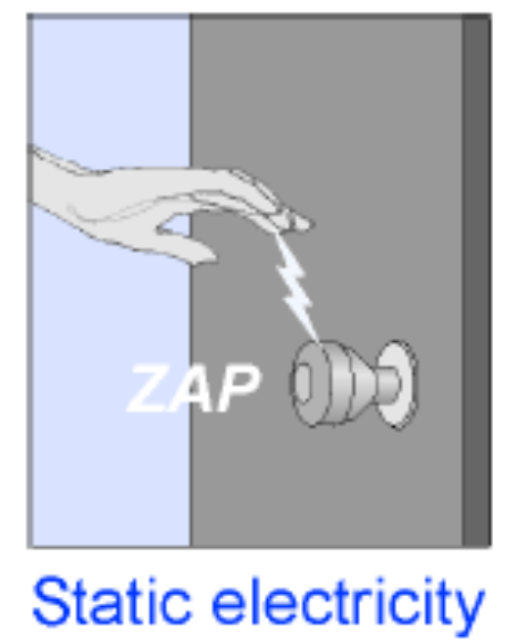
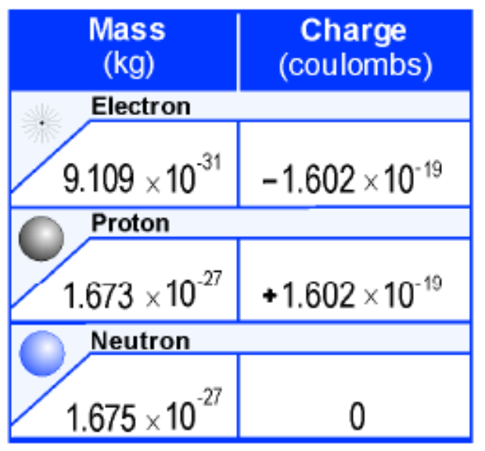
Electric Charge
Objects can lose or gain electric charges.
The net charge is also sometimes called excess charge because a charged object has an excess of either positive or negative charges.
A tiny imbalance in either positive or negative charge on an object is the cause of static electricity.
Electric charge is a property of tiny particles in atoms.
The unit of electric charge is the coulomb (C).
A quantity of charge should always be identified with a positive or a negative sign.

Slide 3
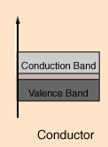
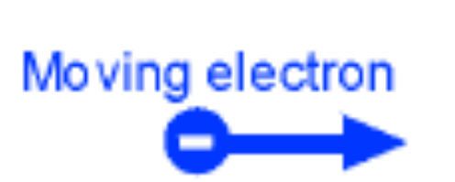

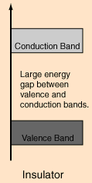

Conductors and insulators
All materials contain electrons.
The electrons are what carry the current in a conductor.
The electrons in insulators are not free to move—they are tightly bound inside atoms.

Slide 4
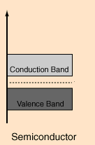
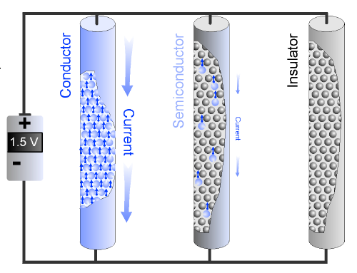
A semiconductor has a few free electrons and atoms with bound electrons that act as insulators.

Slide 5
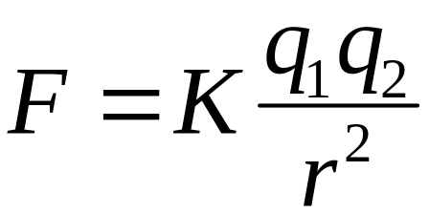
Coulomb’s Law
Coulomb’s law relates the force between two single charges separated by a distance.
Force (F) depends on charge (q)
F ∝ q₁ ; F ∝ q₂
Force depends on the inverse square of the distance (r) between the charges
F ∝ 1/r²
F ∝ (q₁ q₂)/r²
r
F
-
-
q₂
F
q₁

Slide 6
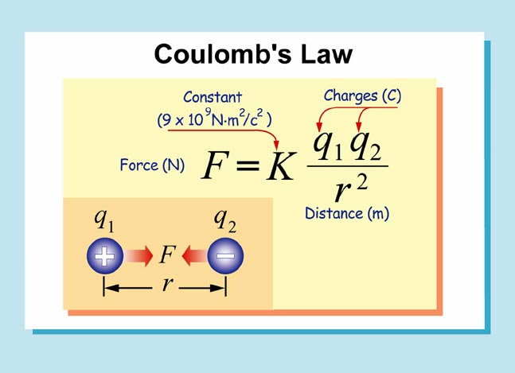


Slide 7
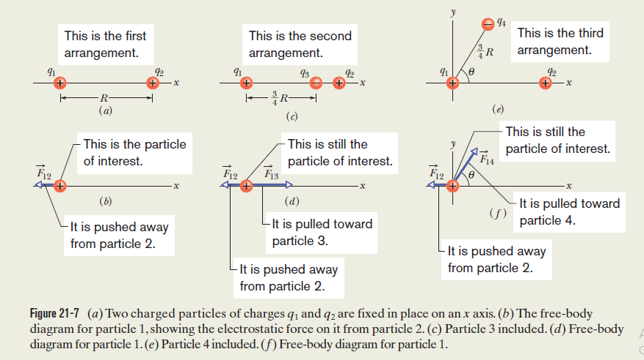

Slide 8
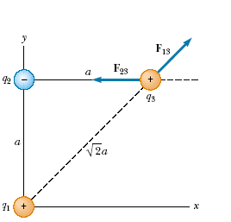




Calculate the Force
Consider three point charges located at the corners of a right triangle as shown in Figure. Find the resultant force exerted on q3 .

Slide 9
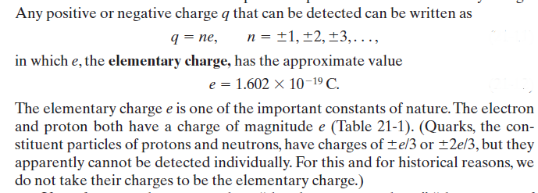
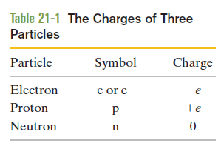
Charge Is Quantized

Slide 10



Charge Is Conserved
If you rub a glass rod with silk, a positive charge appears on the rod. Measurement shows that a negative charge of equal magnitude appears on the silk. This suggests that rubbing does not create charge but only transfers it from one body to another, upsetting the electrical neutrality of each body during the process

